Slide 1
Unit 1 Microsoft Azure Fundamental Concepts & Architectureal Components
Introduction to Azure Core Concepts and Services:
Benefits of cloud computing
Service Models
Types of Cloud Service models
Public, Private, Hybrid Cloud

Slide 2
What is Microsoft Azure?
Cloud computing platform by Microsoft
Offers 200+ products and services
Supports building, testing, and managing applications

Slide 3
Azure Service Models
IaaS – Infrastructure as a Service
PaaS – Platform as a Service
SaaS – Software as a Service

Slide 4
Key Features of Azure
Global reach (60+ regions)
High availability and scalability
Integrated security and compliance
Supports hybrid and multi-cloud
AI, ML, DevOps, and IoT capabilities

Slide 5
Core Azure Services
Compute – VMs, App Services, AKS
Storage – Blob, Queue, File, Disk
Networking – VNet, Load Balancer
Databases – SQL, Cosmos DB
AI & ML – Azure ML, Cognitive Services

Slide 6
Azure Management Tools
Azure Portal
Azure CLI
Azure PowerShell
Azure Resource Manager (ARM)
Azure Monitor and Security Center

Slide 7
Security and Compliance
Built-in security tools
Encryption at rest and in transit
Identity with Azure Active Directory
Compliance with ISO(International Organization for Standardization ), GDPR (General Data Protection Regulation), HIPAA(Health Insurance Portability and Accountability Act)

Slide 8
Real-World Use Cases
Hosting websites and apps
Running virtual desktops
Data analytics and BI
Disaster recovery
IoT and AI solutions

Slide 9
Pricing and Cost Management
Pay-as-you-go pricing
Cost calculator available
Budgets and alerts via Cost Management

Slide 10
Getting Started with Azure
Create a free Azure account
Explore the Azure portal
Use quickstarts and tutorials
Try free services and credits

Slide 11
Overview of Azure subscriptions
Getting An Azure Subscription
Azure Subscriptions can be obtained from Microsoft in a variety of ways:
Enterprise Agreement:
Enterprise customers can make a bulk purchase of subscriptions with an upfront monetary commitment
Consume services throughout the year.
Resellers: Provide a simple, flexible way for medium to large businesses to purchase Azure cloud services.
Partners: They can design and implement your Azure cloud solution for you.
Personal Free Account:
This is the type of account used by most individuals,
Microsoft provides free credits for a limited time so that Companies and/or individuals can try out their services.

Slide 12
Azure Subscriptions Types
Microsoft offers different types of subscriptions tailored to fulfill all types of requirements.
Free:
A free subscription can be created with an email account and a credit card that includes 200$ credit for the first 30 days and free limited access for 12 months when converted to a pay-as-you-go subscription.
Pay-As-You-Go: Generates a monthly charge depending on the amount of Cloud resources used.
Enterprise: A single Enterprise agreement is made for bulk purchases of subscriptions,
with discounts for new licenses and Software Assurance – targeted at enterprise scale – Organizations.
Student: These subscriptions include 100$ for 12 months, this subscription can be activated without a credit card however student verification is required.

Slide 13
There are many ways to help people decide to set up and create multiple Azure subscriptions.
Here are some examples:
Job Segregation
Application Categories
Job Title
Business Units
Geographical Regions

Slide 14
Services Offered by Azure
Service Type | Services Offered
AI & ML | Cognitive Services Azure Machine Learning
Compute | App services Cloud services
Storage | Data storage Azure Data Lake
Containers | Kubernetes service Service fabric
Networking | DDOS protection Firewall manager
Analytics | Analysis services Stream analytics

Slide 15
Continued ..
Service Type | Services Offered
Hybrid & multi-cloud | IOT edge Azure DB for PostgreSQL
Management & governance | Azure backup Chaos studio
Identity & security | Azure AAD Defender for cloud
Media | Encoding Content delivery network
Migration | Azure migrate Azure site recovery
Web | Maps Communication services
Databases | COSMOS DB SQL database

Slide 16
Continued ..
Service Type | Services Offered
Mixed reality | Digital twins Spatial anchors
Developer tools/DevOps | Pipelines VS Code
Virtual desktop | Virtual desktop Citrix virtual apps
DevOps | Artifacts DevOps tool integrations
Mobile | Xamarin API management
Integration | Event grid Azure healthcare APIs
IoT | IOT edge Kinect DK

Slide 17
Azure Portal
Azure Portal is a web-based, unified console for managing Azure resources. With the Azure Portal, we can do the following:
Manage subscriptions
Manage and monitor the application information
Create, delete, and manage Azure resources

Slide 18
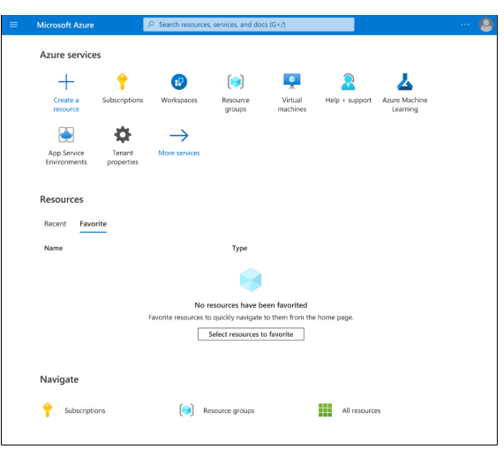
Azure Portal

Slide 19
Azure Marketplace
Azure Marketplace helps connect with Microsoft partners, vendors, and startups. Azure Marketplace customers can find, try, purchase, and provision applications and services from hundreds of leading software providers.

Slide 20
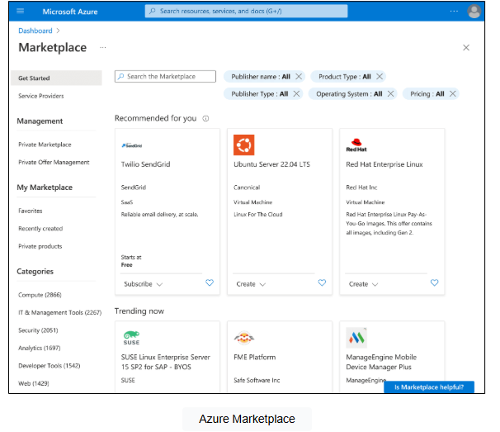

Slide 21
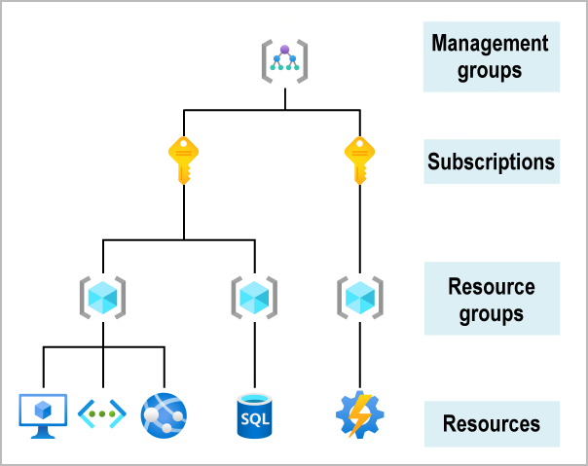
Core Azure Architectural Components
Azure Resource Organising Structure:

Slide 22
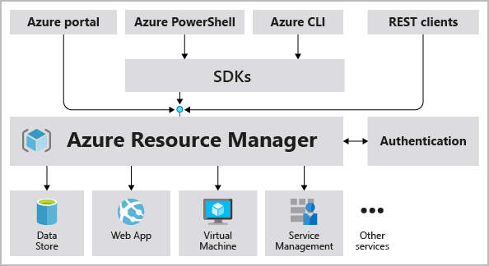
Azure resource manager

Slide 23
Regions
Azure Regions
A region is a geographical area on the planet that contains at least one but potentially multiple datacentres that are nearby and networked together with a low-latency network.
When you deploy a resource in Azure you'll often need to choose the region where you want your resource deployed.
Examples of regions are: West US, Canada Central, West Europe, Australia East
Why are regions important?
Azure has more global regions than any other cloud provider. These regions give you the flexibility to bring applications closer to your users no matter where they are. Global regions provide better scalability and redundancy. They also preserve data residency for your services.

Slide 24
Availability Zones
Availability Zones
These help to make your app highly available. Availability Zones are physically separate datacentres within an Azure region. Each availability zone is made up of one or more datacentres equipped with independent power, cooling, and networking. An availability zone is set up to be an isolation boundary. If one zone goes down, the other continues working.
Availability zones are primarily for VMs, managed disks, load balancers, and SQL databases.

Slide 25
Region Pairs
Region Pairs
Each Azure region is paired with another region for redundancy. This way natural disasters are less likely to affect availability. West US is paired with East US. South East Asia is paired with East Asia. If one goes down the other should still be available.
Planned Azure updates are rolled out to paired regions one region at a time to minimize downtime and risk of application outage.

